Slide 1
2020 CENSUS ENTERPRISE ARCHITECUTRE AND INFRASTRUCTURE TRANSITION PLAN
George Mason University
INFS 774: Enterprise Architecture
Professor Barry Barlow

Slide 2
Meet the team
Team Member | Assignments
Linus Freeman | EA Framework Selection and Customization Enterprise Architecture Business View
Nicholas Vilailack | Enterprise Architecture System View Project Report Overview
Junxiang Wang | Enterprise Architecture Technical View EA Framework Overview

Slide 3


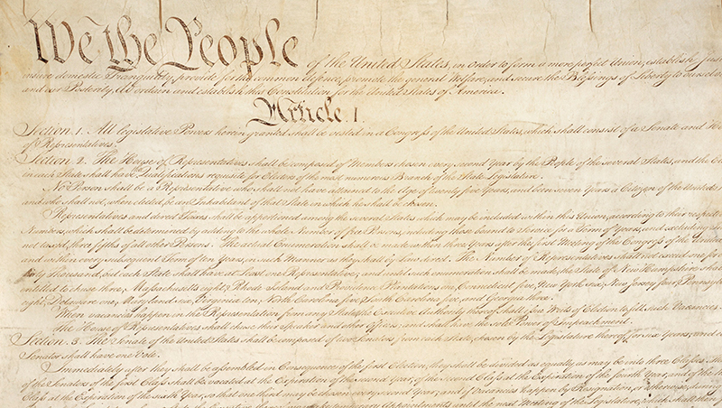

United States Census Bureau
Notes:
The Constitution of the United States (Article I, Section 2) directs the population be enumerated every 10 years.

Slide 4
Census Bureau collects data
Count residents of the United States
Within 4 statistical regions (9 divisions in total)
Northeast, South, Midwest, and West
Conducts various surveys
Surveys range from economics to housing to healthcare to finance
Notes:
Helps the Federal, State, and Local governments to make decisions usually involving money.

Slide 5
Use of Census data
Decide the location of new housing
Examine demographics of various regions
Plan transportation systems and roadways
Determine quotas for police and fire stations
Determine number of seats for each state within the house of representatives
Determine number of electoral votes for each state during the Presidential elections
Notes:
The U.S population is growing, some places more than others. The use of census data with statistics can help lawmakers make better choices and provide rationale for their decisions.

Slide 6


